Slide 1
What is F# and why should I care?
Mike O’Brien
@hcoverlambda
blog.mikeobrien.net

Slide 2
What is F#?
F# is primarily a functional language.
It is multi paradigm so it does allow you to code/consume imperative and OO code.
It’s a .NET language so…
You get all the benefits of the .NET framework.
It can plug right into an existing .NET ecosystem.
It has its roots in ML, a functional language created in the ‘70s.
It ships with VS2010 and is offered as a stand alone download for VS2008 and the CLI.

Slide 3
Why should I care?
For most of us the reason we should care has to do with the functional paradigm, not about F# per se.
Learning the functional paradigm will fundamentally change how you approach and solve computing problems.
I will not be able to prove this to you in an hour.
The only way to truly learn the functional paradigm is in a functional language (Doesn't have to be F#).
Even though learning the functional paradigm is done in a functional language the functional paradigm can be applied in multi paradigm languages that support functional constructs like C# and Ruby.

Slide 4
Programming Paradigms
What is a “programming paradigm”?
“A fundamental style of computer programming” - Wikipedia
Suite of interrelated concepts, idioms, principles and patterns.
Values (IE: Elegance, simplicity, performance, quality, terseness, flexibility, speed of development, parallel computation, managing complexity, etc.)
They embody a lot of stuff.
The functional paradigm is made up of all that stuff too.
The functional paradigm is not a particular language.
A language enables you to express a particular paradigm.

Slide 5
Paradigm Shift
Learning the functional paradigm is not about learning a new language syntax!
If you just do that your not gaining anything.
If you are a OO developer you will initially find it hard to “think functionally”.
Your instincts will be wrong at first, don’t trust them!
Look for a functional way to solve the problem.
Don’t give up, you’ll get it!

Slide 6
Basic F# Syntax
“light” syntax allows you to use indentation to define code blocks. This is the default.
Comments are “//” or “(* … *)”
“let” binds a value to a name.
Tuple – A fixed set of elements
Generic way to represent a small number of items.
Are built right into the F# language unlike C#
Are defined as “(x,y,z,…)”
The type is represented as “(int * int * string * …)”
Function bindings
Parameters – Separated by a space.
Tuple – This can be confusing to C#’ers.
Interestingly both compile to the same thing but the non tupled form has a special attribute applied to it.

Slide 7
Declarative
The functional paradigm is a declarative paradigm.
It focuses on “what” as opposed to “how”.
The imperative paradigm is the opposite as it focuses on “how”.
Examples of functional languages:
SQL
XSLT
HTML
For example the list functions that are synonomous with the LINQ extensions methods (IE .Select, .Sum, etc).
Keep your eyes open for this as we continue.

Slide 8
Immutability
In other words, you cant change it (Or “mutate” it) after it’s been set.
Thus we talk about “values” and not “variables” (Because it cant vary).
This can be overridden with the “mutable” keyword and using the “<-” assignment operator. (But prolly means ur doing it wrong)
This is not a bad thing. The functional paradigm solves problems in such a way that doesn't require the maintenance of mutable state whereas imperative/OO is all about it.
This simplifies and clarifies the code.
Opens the door for easy parallelization (Nothing to lock, no race conditions, etc).

Slide 9

Type Inference
F# is strongly typed.
Makes heavy use of type inference.
In fact you RARELY have to specify a type.
F# attempts to generalize types, by making them generic, when possible (Automatic Generalization).
C# has limited type inference
With local variables via the “var” keyword.
With generic type parameters.
“But, but, I need types, this is weird!”
Working in F# helps you realize that explicit type specifications ARE NOT important and not needed.
But this is well engrained so its hard to let go.

Slide 10
First-class & Higher-order Functions
A language is said to support first-class functions if:
They are treated like a type that can be passed into and returned by other functions.
They can be created like any other type.
C# provides support for first-class functions by means of the delegate type and anonymous methods and lambda expressions.
F# similarly supports first-class functions although the delegate type is an implementation detail not generally visible in the language itself. Lambda functions are supported as well.
Higher-order functions are simply functions that take a function as a parameter or return a function.

Slide 11
Lambdas
Lambda expressions, aka lambda functions, aka lambdas, aka anonymous functions are first-class functions that are not bound to an identifier.
So in other words they aren't given a name but defined “on the fly”.
In C# these are called “lambda expressions”, in F# “lambda functions”.
They can be assigned to a value (F#) or variable (C#) or passed directly to another function.
They are compact and terse.

Slide 12
Closures
Closures are first-class functions that lift values/variables from the scope in which they are declared.
This would include local values/variables scoped to a function (Who’s scope lasts only the life of the function because the values are on the stack).
This would not include class level values/variables as their scope lives on (On the heap) as long as there is a reference to the object.
The values are “closed over”. In C#/F# this means the compiler generates a class with a copy of the values from the scope that goes along with the first-class function.
If no values are lifted from their scope its not a closure.
Technically a closure doesn't have to be a lambda and a lambda doesn't have to be a closure. The concepts are orthogonal!
In practice however (With C# & F#) the concept of closures is only relevant to lambdas, as other first-class functions do not need variables in their scope to be lifted.
Because of this, colloquially the term “lambda” and “closure” are used interchangeably.

Slide 13
Currying
Has nothing to do with Indian food (Lets get that joke out of the way). Comes from Haskell Curry’s last name.
Breaks up a multiple parameter function into multiple single parameter functions.
F# functions are curried out of the box if you don’t pass parameters in tupled form (Remember what that is?).
C# functions are not curried out of the box.
Why in the world would someone want to do that??
Lets go to the next slide to find out…

Slide 14
Partial Application
Partial application means that we create a new function from an existing function by defining some of its parameters.
Currying != partial application
Currying enables partial application

Slide 15
Recursion
Recursion is essentially a function calling itself.
It is an alternative to the imperative notion of loops.
Can cause a stack overflow!
The fix? Tail call optimization!
With C# TCO is not a compiler optimization. IF it happens it will be a JIT/ngen optimization. Don’t rely on it because there are number of factors that determine if the JIT/ngen will actually do it.
The F# compiler guarantees the TCO so use it all you want.

Slide 16
Function Composition
Functions can be composed.
Pipelining with “|>”

Slide 17
There’s a lot more
Pattern matching
Discriminated unions
Sequence expressions
Async workflows
And the list goes on!

Slide 18
Applied F#
“If F# (Or any functional language) is not supplanting my day to day OO language where can I use it?”
Prototyping
Scripting (Yes, F# scripting!)
Build scripts (FAKE, F# Make: http://bitbucket.org/forki/fake/wiki/Home)
Short lived tools (In application or script form)
Personal projects (Including MVC and Silverlight projects)
OSS projects
Project Euler (http://projecteuler.net/)
Make use of the functional paradigm in your multi paradigm OO language to solve problems.

Slide 19
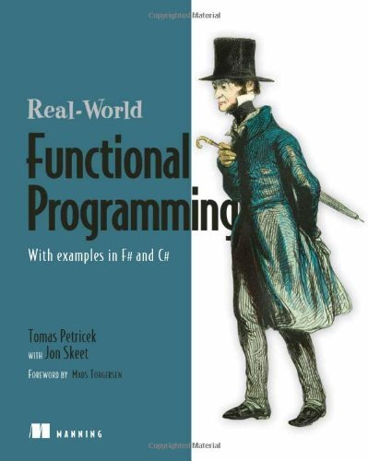
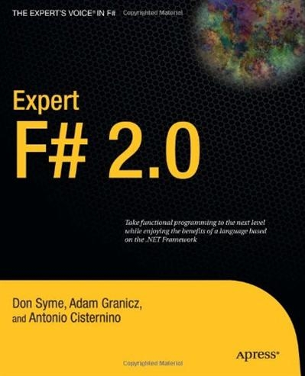
Learning Resources
Blogs
Don Syme (Rhymes with time) - http://blogs.msdn.com/b/dsyme/
Tomas Petricek (Pet-tree-sec) - http://tomasp.net/blog/
Matthew Podwysocki - http://weblogs.asp.net/podwysocki/
Books

Slide 20

That’s all folks…
Slides, downloads and links @ http://blog.mikeobrien.net

